Slide 1

Sentiment Analysis of News for Stock movement prediction

Slide 2
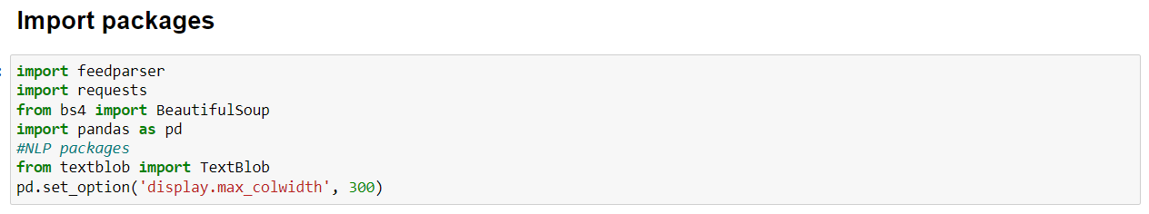
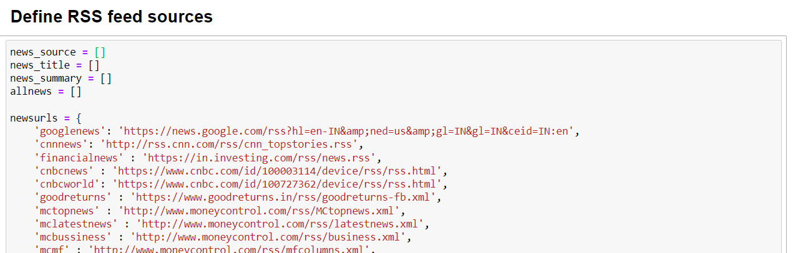

Slide 3
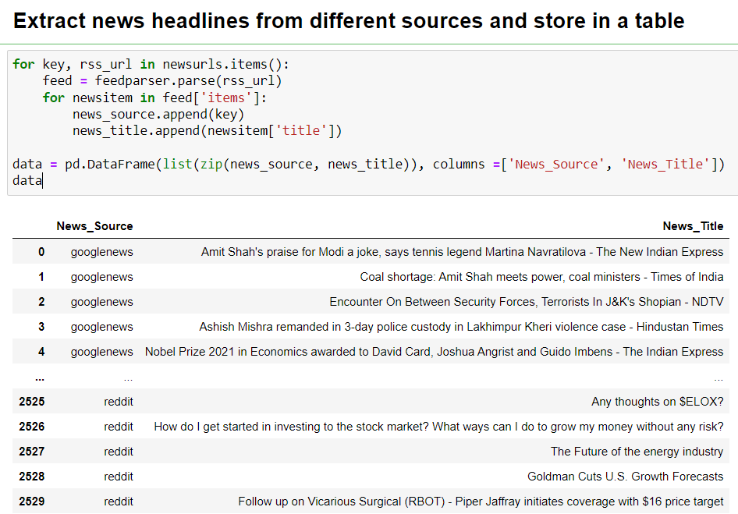

Slide 4
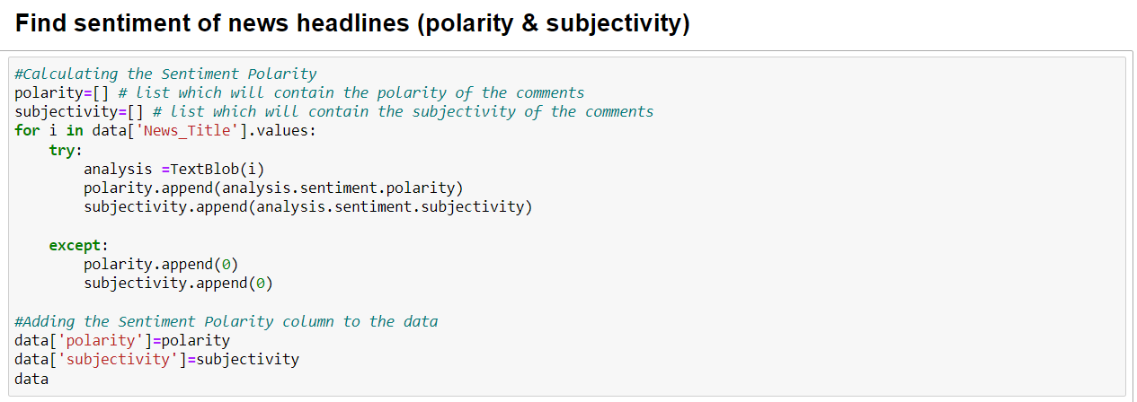

Slide 5
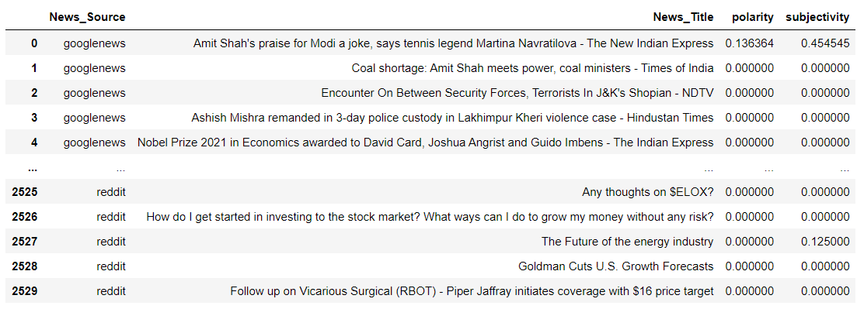
News Sentiment

Slide 6
News Sentiment
# | News_Source | News_Title | polarity | subjectivity
0 | googlenews | Amit Shah's praise for Modi a joke, says tennis legend Martina Navratilova - The New Indian Express | 0.14 | 0.45
1 | googlenews | Coal shortage: Amit Shah meets power, coal ministers - Times of India | 0.00 | 0.00
2 | googlenews | Encounter On Between Security Forces, Terrorists In J&K's Shopian - NDTV | 0.00 | 0.00
3 | googlenews | Ashish Mishra remanded in 3-day police custody in Lakhimpur Kheri violence case - Hindustan Times | 0.00 | 0.00
4 | googlenews | Nobel Prize 2021 in Economics awarded to David Card, Joshua Angrist and Guido Imbens - The Indian Express | 0.00 | 0.00
5 | googlenews | India never had more decisive government: PM Modi - The Hindu | 0.50 | 0.50
6 | googlenews | Durga In No Man's Land: Kolkata Pandal Highlights NRC, Migrant Crisis - NDTV | 0.00 | 0.00
7 | googlenews | DNA Exclusive: Are India-China heading towards Galwan 2.0? All details on LAC standoff here - Zee News | 0.00 | 0.00
8 | googlenews | Daily Covid tally under 500 in Mumbai, but weekly rate sees a surge - Times of India | 0.00 | 0.00
9 | googlenews | JCO, 4 soldiers killed in Poonch gunfight with terrorists - Times of India | -0.20 | 0.00
10 | googlenews | Imran bats for engaging Taliban, warns against hardline faction gaining upper hand - Times of India | 0.20 | 0.35
11 | googlenews | "Despite Grim Economy...": North Korea's Kim Jong Un Outlines "Crucial" Work - NDTV | -0.50 | 1.00
12 | googlenews | "Pretty Brutal Scene For Our Guys": 2 Die As Plane Hits Houses In US - NDTV | -0.31 | 1.00
13 | googlenews | Sydney Lockdown Ends After "100 Days Of Blood, Sweat And No Beers" - NDTV | 0.00 | 0.00
14 | googlenews | Air India privatisation reflects govt resolve to bite reform bullet: CII - Moneycontrol | 0.00 | 0.00
15 | googlenews | Kumar Mangalam Birla may infuse own capital into Vodafone Idea - Economic Times | 0.40 | 0.60
16 | googlenews | Rupee drops below 75 on rising crude oil, bond yields surge - Times of India | -0.70 | 1.00
17 | googlenews | Worried Sony-Zee deal will enrich Chandra family at cost of shareholders: Invesco - CNBCTV18 | 0.00 | 0.00
18 | googlenews | WhatsApp to allow users to pause voice recording for shorter, clearer messages - Zee News | 0.00 | 0.00
19 | googlenews | Moto E40 Set to Launch in India Today: Expected Price, Specifications - Gadgets 360 | -0.10 | 0.40
20 | googlenews | ColorOS 12: Top features in Android 12 for Oppo Find X3 Pro! - Android Central | 0.31 | 0.38
21 | googlenews | Best Buy is selling PS5 consoles, but access is restricted to its new $200 membership scheme - Video Games Chronicle | 0.57 | 0.38

